Slide 1

Brews And Breweries
6/14/2022

Slide 2
Summary:
Dataset Description
Dataset Preparation
Alcohol Content by State
International Bitterness Unit by State
Alcohol Content vs International Bitterness Unit
Comparing India Pale Ales and other Ales

Slide 3
Dataset Preparation
There are two base datasets. One dataset describes the city and state location of various breweries within the USA and the other dataset describes the beers served at various breweries.
Note: The District of Columbia is included in State column, meaning there are 51 unique values for the State Column.
These two datasets were then merged into one dataset, using the breweries ID column as the common feature.

Slide 4
Dataset Preparation ***This slide is not necessary**
Example: The first and last 6 rows in the merged dataset.
Note missing values (NA) for IBU
First 6 Rows in Merged Dataset
Brew_ID | Name | City | State | Beer | Beer_ID | ABV | IBU | Style | Ounces
1 | NorthGate Brewing | Minneapolis | MN | Pumpion | 2689 | 0.06 | 38 | Pumpkin Ale | 16
1 | NorthGate Brewing | Minneapolis | MN | Stronghold | 2688 | 0.06 | 25 | American Porter | 16
1 | NorthGate Brewing | Minneapolis | MN | Parapet ESB | 2687 | 0.056 | 47 | Extra Special / Strong Bitter (ESB) | 16
1 | NorthGate Brewing | Minneapolis | MN | Get Together | 2692 | 0.045 | 50 | American IPA | 16
1 | NorthGate Brewing | Minneapolis | MN | Maggie's Leap | 2691 | 0.049 | 26 | Milk / Sweet Stout | 16
1 | NorthGate Brewing | Minneapolis | MN | Wall's End | 2690 | 0.048 | 19 | English Brown Ale | 16
Last 6 Rows in Merged Dataset
Brew_ID | Name | City | State | Beer | Beer_ID | ABV | IBU | Style | Ounces
556 | Ukiah Brewing Company | Ukiah | CA | Pilsner Ukiah | 98 | 0.055 | NA | German Pilsener | 12
557 | Butternuts Beer and Ale | Garrattsville | NY | Porkslap Pale Ale | 49 | 0.043 | NA | American Pale Ale (APA) | 12
557 | Butternuts Beer and Ale | Garrattsville | NY | Snapperhead IPA | 51 | 0.068 | NA | American IPA | 12
557 | Butternuts Beer and Ale | Garrattsville | NY | Moo Thunder Stout | 50 | 0.049 | NA | Milk / Sweet Stout | 12
557 | Butternuts Beer and Ale | Garrattsville | NY | Heinnieweisse Weissebier | 52 | 0.049 | NA | Hefeweizen | 12
558 | Sleeping Lady Brewing Company | Anchorage | AK | Urban Wilderness Pale Ale | 30 | 0.049 | NA | English Pale Ale | 12

Slide 5
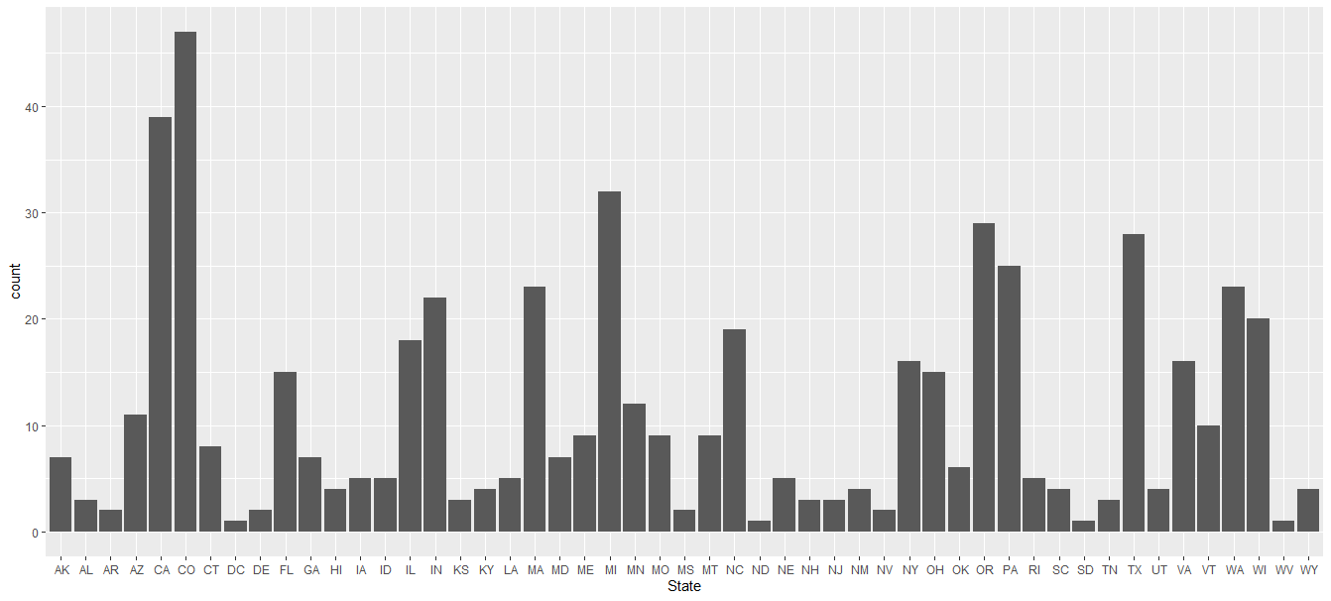
Dataset Description: Breweries per State
In the US, there is an average of 11 breweries per state.
The state of Colorado had the greatest number of breweries with 47.

Slide 6
Dataset Preparation: Missing Values
As noted previously, there are missing values in the merged dataset
To be exact, there are 1,067 missing values in the total dataset , 1005 of which are in the IBU column. The other 62 missing values are in the ABV column.

Slide 7
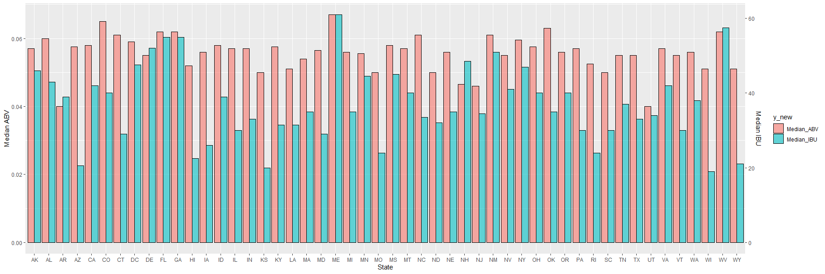
Alcohol Content vs International Bitterness Unit

Slide 8
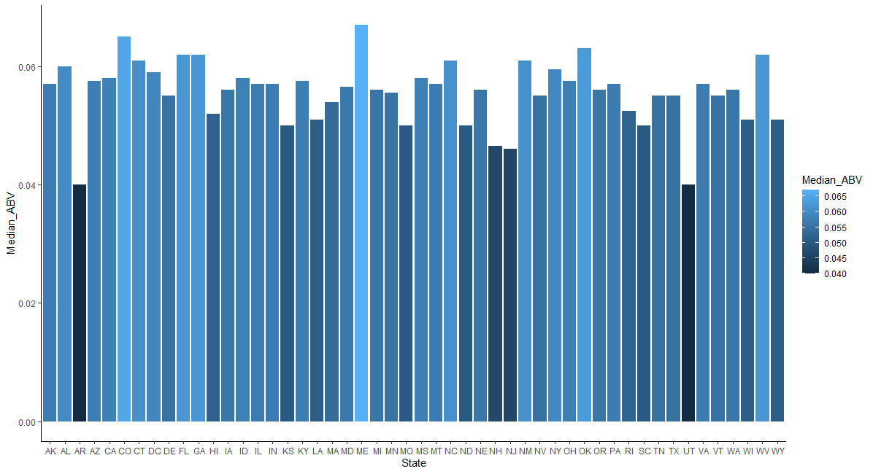
Alcohol Content (ABV) by State
Median ABV by State for the US has a mean of 0.05564, with a min of 0.4 for Utah and Arkansas and a max of 0.67 for Maine.

Slide 9
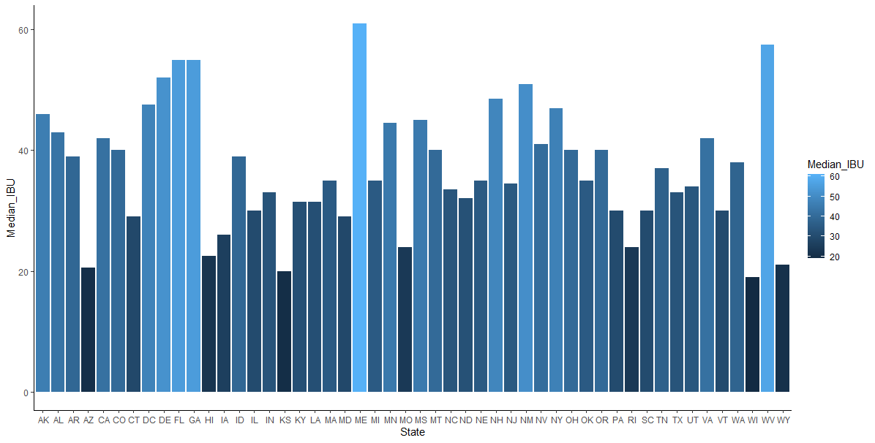
International Bitterness Unit (IBU) by State
Median IBU by State for the US has a mean of 36.98, with a min of 19 for Wisconsin and a max of 61 for Maine.

Slide 10
Maxi/Mini for ABV and IBU
The maximum ABV is 0.128 offered by Upslope Brewing Company in Boulder, CO.
The minimum ABV is 0.001 offered by Uncommon Brewers in Santa Cruz, CA.
The maximum IBU is 138 offered by Astoria Brewing Company in Astoria, OR.
The minimum IBU is 4 offered by Anderson Valley Brewing Company in Boonville, CA.

Slide 11
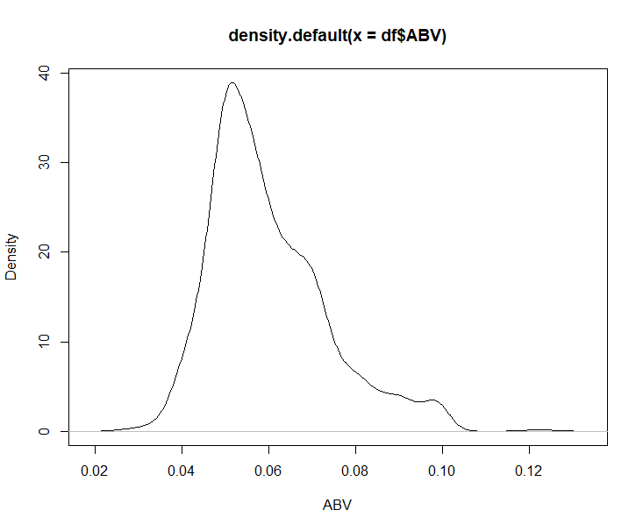
ABV Summary
The ABV column originally had 62 missing values
The maximum ABV is 0.128 or 12.8%
The minimum ABV is 0.001 or 0.1%
The mean ABV is 0.05977 and the median is 0.056.

Slide 12
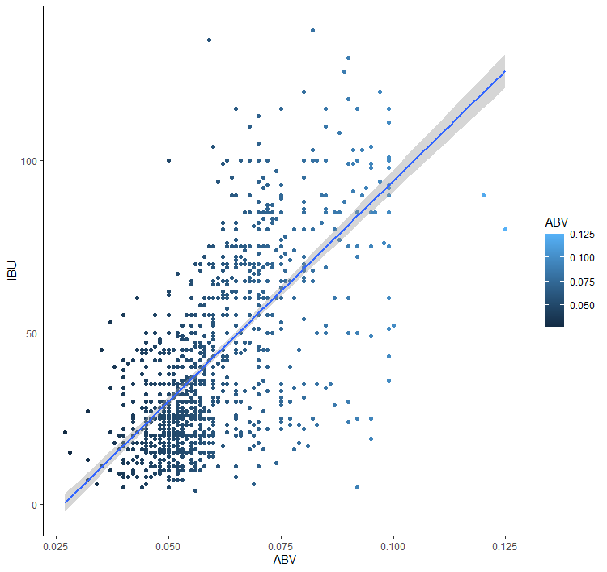
ABV vs. IBU
It appears that ABV and IBU are somewhat correlated.
The logic to this being that increased bitterness can mask the taste of increased alcohol content.

Slide 13
Comparing India Pale Ales and other Ales

